Slide 1
ACC Articulation Credit Exam
2018-2019
Round Rock High School

Slide 2
Internet Basics
Advanced Research Projects Agency Network (ARPANET)
The predecessor of the Internet.
It was the first network to implement the protocol suite TCP/IP.
Both technologies became the technical foundation of the Internet.
Application Service Provider (ASP)
Companies that manage and distribute Web-based software services to customers over the Internet.
Cloud Computing
Refers to data, applications, and even resources stored on computers accessed over the Internet.
World Wide Web (WWW)
Refers to one resource available through the Internet.
Collection of Web pages that are interconnected through the use of hypertext or links.

Slide 3
Type of Internet Connections

Slide 4
Internet Connection Devices
A Wi-Fi hotspot is a location with a direct Internet connection and a wireless access point that allows users to connect wirelessly to the Internet.
DSL (Digital Subscriber Line) – direct connection that transmits via a standard telephone line but does not tie up your telephone line.
  Conventional telephone lines use analog or continuous wave signals

Slide 5
Network
A network is a collection of computers and other hardware devices that are connected so users can share hardware, software and data as well as communicate with each other electronically.
A network allows individuals to work from a remote location (typically their home) and communicate with their places of business and clients via networking technologies.

Slide 6
HTTPS
HTTPS stands for "HyperText Transport Protocol Secure"
  It uses a secure socket layer (SSL) for security purposes.
  Some examples of sites that use HTTPS include banking and investment websites, e-commerce websites, and most websites that require you to log in.
  When shopping at an e-commerce Web site, make sure you only enter payment information on a secure Web page, one with a URL that begins with https.

Slide 7
Online Companies
Online shopping and online investing are examples of e-commerce which is a term meaning online financial transactions.
Third party cookies are placed on your hard drive by a company other than the one associated with the Web page you are viewing.
Infrastructure companies are enterprises that own or operate the paths or “roadways” along which Internet data travels.

Slide 8
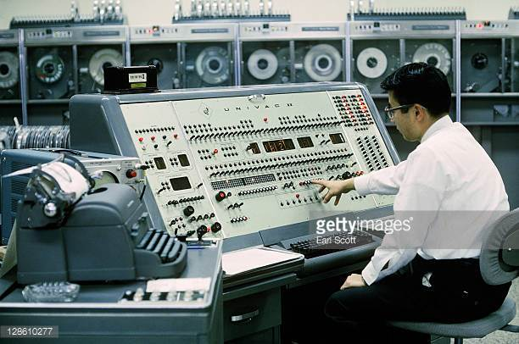
UNIVAC
UNIVAC is an acronym for UNIVersal Automatic Computer
UNIVAC is an example of a first- generation computer.
In 1952, the UNIVAC helped out in the local Eisenhower for President campaign office. At that time, there was talk of a fancy new machine that was going to help count and analyze the votes that year.
It was the first time computers were brought in to help predict the outcome. That event in 1952 helped usher in the computer age.

Slide 9
Computers
A computer is a programmable, electronic device that accepts data, performs operations on that data, presents the results, and stores the data or results as needed.
Type of Personal computers:
  Desktop computers - stationary computer designed to fit on or next to a desk
  Portable/ Notebook computers (laptop computers) – fits in briefcase or on lap
  Netbook (very small notebook computer) - small, light, low-power notebook computer that has less processing power than a full-sized laptop but is still suitable for word processing, running a Web browser and connecting wirelessly to the Internet
  Handheld computers such as Smartphones (Personal Digital Assistant or PDA) and Electronic Readers

Slide 10
Servers & Workstations
Workstations: Powerful desktop computers designed for specialized tasks
  Mainframe: Large, expensive computers that can process data for thousands of users
  Supercomputers: Fastest computers that can handle tasks too complex for other computers
Servers: Special networked computers that share/serve data to other computers
  Minicomputer: a small computer that can be used to operate & maintain a network for computer lab.
  Downloading – client retrieves files from a server

Slide 11
Hardware
Software
Hardware is physical parts of a computer
Main circuit board inside the computer system is called the motherboard.
Router manufacturer, maker of the latest Web browser, computer designer are examples of hardware and software companies.
Software is programs or instructions used to tell the computer hardware what to do.
Byte - number of bits used to encode a single character of text (8 bits = 1 byte)
A word is the amount of data (measured in bits/bytes) that a CPU can manipulate at one time

Slide 12
Operating Systems
Mac OS – Proprietary operating system for Apple Inc.
Windows - Proprietary operating system for Microsoft
Unix - an operating system commonly used in internet servers, workstations and PCs by Solaris, Intel, HP etc
Linux – open source, free to use operating system widely used for computer hardware and software, game development, tablet PCS, mainframes etc

Slide 13
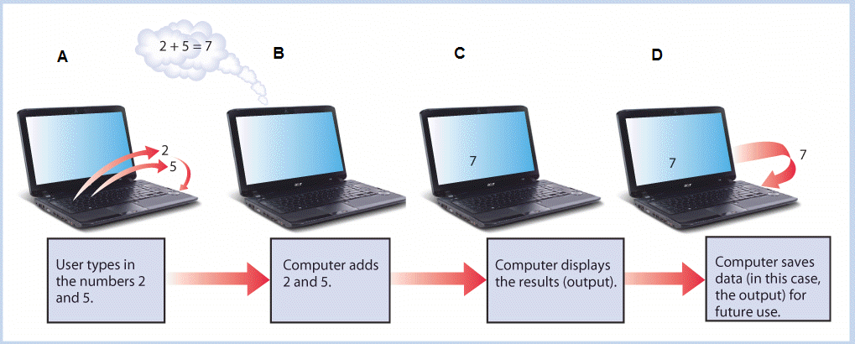
IPOS Cycle
(Input, Process, Output, Storage)

Slide 14
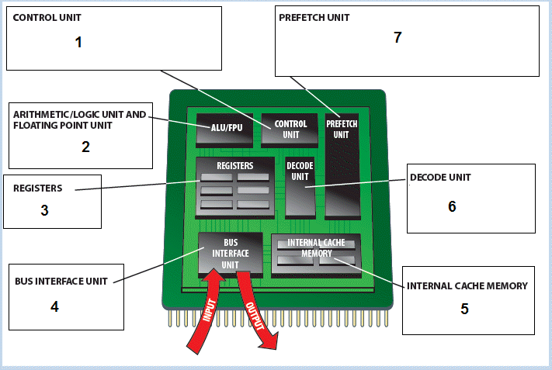
Central Processing Unit (CPU)
tells the computer's memory, arithmetic/logic unit and input and output devices on how to respond to a program's instructions
Speeds up the execution of a program by reducing wait states. Processor requests instruction or data from main memory before it is actually needed.
digital circuit used to perform arithmetic and logic operations
process by which a computer retrieves a program instruction from its memory, determines what actions the instruction dictates, and carries out those actions
Holds data for the computer processor
(BIU) provides various functions, including generation of the memory and I/O addresses for the transfer of data
stores program instructions that are frequently re-referenced by software during operation.

Slide 15
Data Processing
Computers process data (input) into information (output).
CPU is also known as the processor.
Optical Character Recognition (OCR) – ability of a computer to recognize text characters.
Radio Frequency Identification (RFID) – stores and transmits data and is most largely used in shipping containers and large assets
File System - keeps track of the files stored on a computer so that they can be retrieved when needed.
Motherboard – main circuit board inside the system unit

Slide 16

Vector Graphics
Vector graphics is mathematical formulas to represent image content instead of pixels.
It uses polygons to represent images in computer graphics. Vector graphics are based on vectors which lead through locations called control points or nodes.
Files such as engineering drawings are typically printed as bitmaps after vector-to-raster conversion.

Slide 17
Top Level Domain (TLD) Classification
Name | Entity
.org | organization
.net | network
.int | international organizations
.edu | education
.com | commercial
  Financial implications: Registering a Top Level Domain (TLD) may cost as much as $100,000
Legal implications: As of 2012, TLDs can now be created and assigned to brand owners, existing registrars and entrepreneurs
Technical implications: The global addressing system that identifies an actual physical point on the Internet. It is the way that domain names are located and translated into Internet Protocol (IP) addresses.

Slide 18
Email
An email address consists of a username, followed by an @ symbol, followed by the domain name of the mail server.
Mail message parts include Recipient’s email address, Address of additional recipients, Message subject and body, Optional -File attachments
Email accounts need an email provider (Internet service provider or ISP)
Examples of email are Gmail, Hotmail, etc.
Emails are Unique Identifiers

Slide 19
Communication
Social Networking is the practice of expanding the number of one's business and/or social contacts by making connections through individuals.
Facebook, Twitter, and LinkedIn are examples.
Instant Messaging (IM) allows you to exchange real-time typed messages with people on your buddy list.
A blog is a Web page that contains short, frequently updated entries in chronological order, typically as a means of expression or communication.
A wiki Web site operates on a principle of collaborative trust. Allow users to create and edit content (ie. Wikipedia)
  The term "wiki" comes from the Hawaiian phrase, "wiki wiki," which means "super fast.“

Slide 20
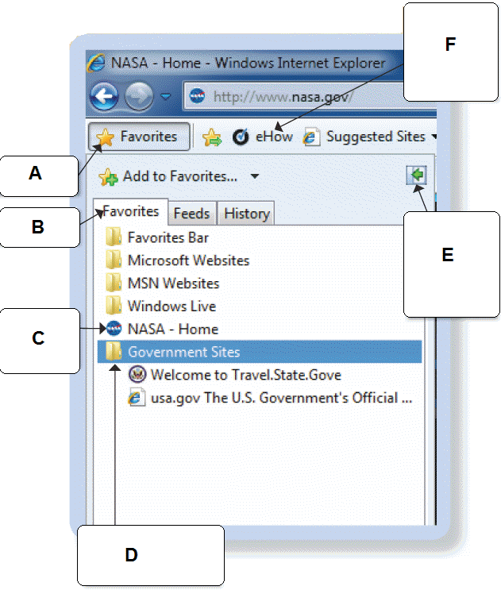
Favorites Bar
The accompanying figure shows the Favorites Center.
This figure also shows NASA-Home is a favorite that has been added to the Favorites bar.

Slide 21
Internet Security Threats
Unauthorized access occurs whenever an individual gains access to a computer, network, file, or other resource without permission. Few examples are:
Viruses - computer program developed intentionally to corrupt the files, applications, data, etc. of a computer
Spoofing – impersonated e-mail reader is misguided to irrelevant path other than that of the original destination; tricks people into giving personal information to thief
Worm – sent to other computers via an email attachment; program can run itself and does not need a host

Slide 22
Intellectual Property
Intellectual property is an original creative work.
Copyrights remain in effect until 70 years after the creator’s death.
Presenting someone else’s work as your own is plagiarism.
Ethical beliefs may vary based on religion, culture and country.
Copyright gives the holder the exclusive right to publish, reproduce, distribute, perform, or display his or her work.

