Slide 1
How to Shake Hands
Walsh Middle School BIM
9/4/15

Slide 2
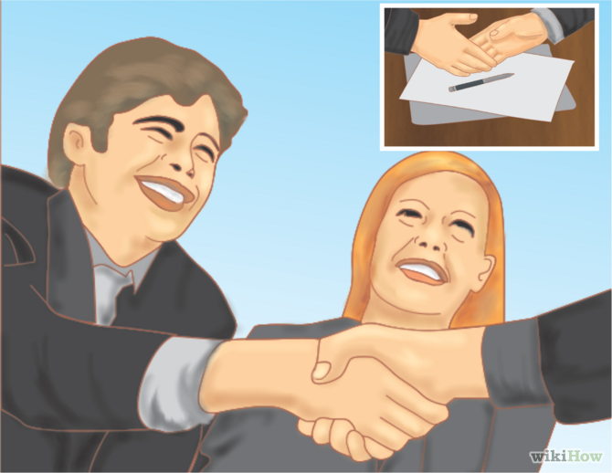
Know when to use your handshake
The appropriate times to shake another person's hand include:
When you are introduced to someone
When you say goodbye to someone
At the beginning or the end of a business, or other meeting
Whenever it seems appropriate within a business context, such as sealing a deal.

Slide 3
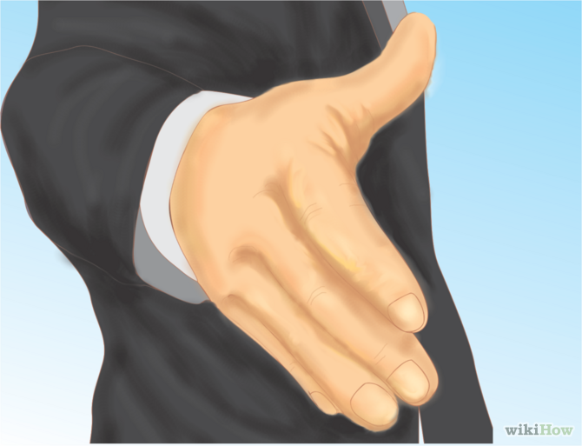
Be the first to extend your hand
This makes a strong, lasting impression on the person at the receiving end. It is also about control; by offering your hand first, you are leading the way.
This applies to both men and women; don't shy away for reasons of being coy or putting yourself down.
The only time that you should not seek to do so is where there is an authority structure in place that should be adhered to. (President, Governor-General, CEO etc.).

Slide 4
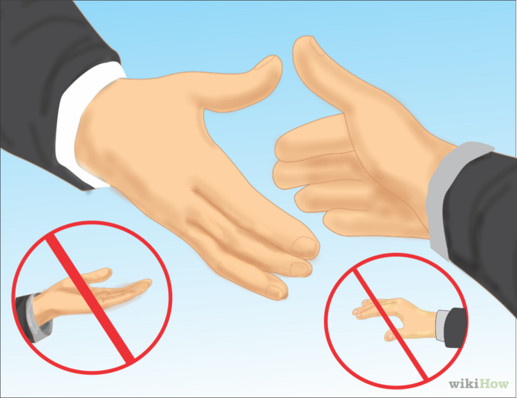
Extend your right hand straight
Do not have your palm facing either up or down; the palm should meet with the palm of the other person.
The exception to using the right hand is if you don't have one, if it is paralyzed or otherwise seriously injured.

Slide 5
Take the other person's hand
Use a firm but not rock-hard clasp
Make sure that the web located between your thumb and fingers meets the web of the other person's hand.

Slide 6
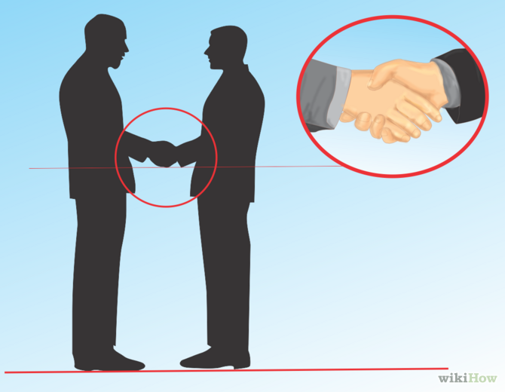
Keep your hand perpendicular
Perpendicular to the ground.
Do not roll it sideways for the handshake.

Slide 7
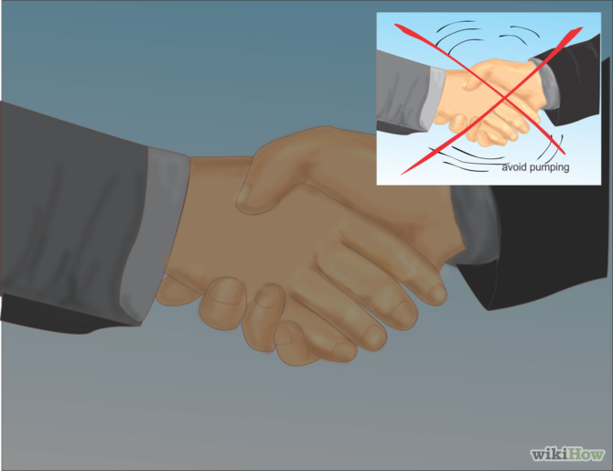
Shake firm once, or at the most, twice
Avoid pumping; more shakes than two becomes annoying and distracting from the purpose of the handshake
A normal handshake lasts about 5 seconds.
.

Slide 8
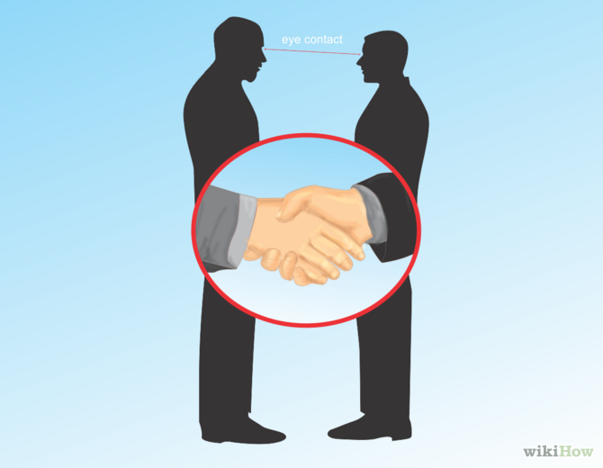
Make eye contact
Convey confidence in both your handshake and stance.
State your usual greetings.
Hello, My Name Is…
Not Howdy or Hey
Use Proper Names
Use Mr. or Mrs.

